Slide 1
Exhaustive Search
Permutations

Slide 2
Definition: When given a sequence/set of elements, a permutation is one arrangement of such elements.
Given: {a, b, c}
A permutation is: {b, a, c}
Another permutation is: {b, c, a}
Another one is: {a, b, c}

Slide 3
A set of n distinct elements has n! permutations.
If you are asked to generate and print all permutations of a set of elements, how would you do it?
One way, “called filtering” is by using the previous knowledge of k-Ary strings and filter out the
combinations that aren’t permutations.

Slide 4

If you remember:
function kAry(i, n, Array, k, Basket)
if i == n then
print(Array)
return
end if
for(l from 0 to k - 1 step 1)
Array[i] ← Basket[l]
kAry(i + 1, n, k, Basket)
end loop
end function
If we take: n $≡$ k
Set to be Basket
Modify print to print_If_Valid
then the code becomes:

Slide 5
function Arrange(i, n, Array, Basket)
if i == n then
print_If_Valid(Array)
return
end if
for(l from 0 to n - 1 step 1)
Array[i] ← Basket[l]
Arrange(i + 1, n, Array, Basket)
end loop
end function
Prints only the arrangements
Basket is originally the Array

Slide 6
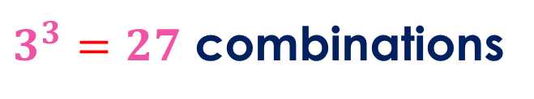
The previous code will print only all the valid permutations, but it will generate all of them.
If we take the Set = {x, y, z} for example: the k-Ary based code will generate all these:
x x x
x x y
x x z
x y x
x y y
x y z
x z x
x z y
x z z
y x x
y x y
y x z
y y x
y y y
y y z
y z x
y z y
y z z
z x x
z x y
z x z
z y x
z y y
z y z
z z x
z z y
z z z
$3^{3}=27$ combinations

Slide 7
The previous code will print only all the valid permutations, but it will generate all of them.
If we take the Set = {x, y, z} for example: the k-Ary based code will generate all these:
x x x
x x y
x x z
x y x
x y y
x y z
x z x
x z y
x z z
y x x
y x y
y x z
y y x
y y y
y y z
y z x
y z y
y z z
z x x
z x y
z x z
z y x
z y y
z y z
z z x
z z y
z z z
$3^{3}=27$ combinations

Slide 8
The code will print only these:
x y z
x z y
y x z
y z x
z x y
z y x
Only: 3! = 6 permutations

Slide 9

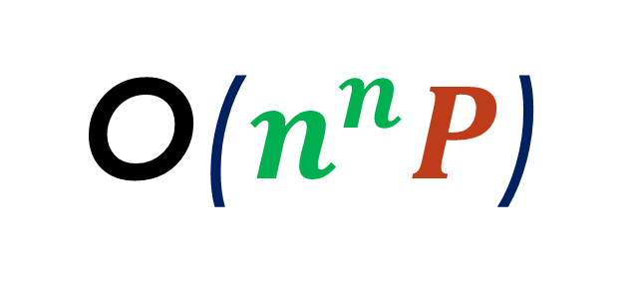
The code runs on auxiliary time:
O($n^{n}P$)
P → the print/check function’s time.
$$P=(n\log{n+n})$$

Slide 10
Thank you!
To be continued…

